Slide 1






2025 SPARK ACADEMY
TRAIN FOR CHANGE, FROM SCIENCE TO PRACTICE
THE SPRINT AI TRAINING FOR AFRICAN MEDICAL
Imaging Knowledge Translation (SPARK)
Academy
IN DEEP LEARNING & MEDICAL IMAGING
Virtual Foundational Course Tutorial
custom data Preparation
April 5, 2025

Slide 2
2025 Onboarding
AGenda
Some Tips on data preparation
Overfitting and underfitting
Assignment preview
https://event.fourwaves.com/spark

Slide 3
Section I
custom data i

Slide 4
Learning Outcomes
Define the typical dataset splits for deep learning
Define underfitting and overfitting, and outline techniques to detect and address them
Describe the steps, advantages, and disadvantages of cross-validation
Maximize representation for a deep learning experimental dataset
Explain the process of data curation
Describe memory allocation when loading data to use with Colab
4

Slide 5
What do I mean by data?
Data

Slide 6
Data
Features: smoking history, age
Targets: cancer or non-cancer
1D Signals: ECG, EMG, EEG
2D Images: natural images, digitized microscopy, fluorescence imaging
3D Images: CT scans, MRI

Slide 7
Partitioning data for the neural network
In Live Coding Session 2 :
We trained a model to classify handwritten digits
We used the MNIST database
MNIST

Slide 8
Partitioning data for the neural network
Training set
60,000
Test set
MNIST
10,000

Slide 9
Partitioning data for the neural network
Training set
60,000
Test set
MNIST
10,000
Why do we not use all our data to train and test our network?

Slide 10
The question we are trying to answer
How well does our model perform on our dataset?
Use to us: did the model fit our dataset?
Not useful to others: it doesn’t quantify how well it’s likely to perform on their data – highly optimistic
How well does the model perform on unseen data from the population?

Slide 11
Statistics refresher
Population
The entire set of similar items that exist in the world, have ever existed or will ever exist
Your dataset is a subset of a population
Terminology note
In statistics, a sample is a subset of the population
Your dataset is a “statistics sample”
We use sample in this course to mean one instance of the population (e.g. one patient, one event)
We use datapoint to mean one item associated with that sample (e.g. one image, one target)

Slide 12
Statistics refresher
The population
Your dataset
A sample
Which has one or more datapoints

Slide 13
The question we are trying to answer
How well does our model perform on our dataset?
Use to us: did the model fit our dataset?
Not useful to others: it doesn’t quantify how well it’s likely to perform on their data – highly optimistic
How well does the model perform on unseen data from the population?

Slide 14
The question we are trying to answer
How well does our model perform on our dataset?
Use to us: did the model fit our dataset?
Not useful to others: it doesn’t quantify how well it’s likely to perform on their data – highly optimistic
How well does the model perform on unseen data from the population?
A test set is a collection of unseen data from the population

Slide 15
Training and test sets
Test
dataset
Training

Slide 16
The question we are trying to answer
Training set – for learning
Informs the parameters: weights and biases of model
Test set – for evaluation
Informs performance on unseen data. Not used until model is completely fixed
Test
Training

Slide 17
Key takeaway: Separate data should be used for training and testing!
DATA

Slide 18
Working scheme for neural network experiments
Train model with training set
Evaluate model using test set
Feed-forward & Backprop

Slide 19
Example
Training a neural network to classify objects into one of two groups, A and B, based on two features x⁰ and x¹.
Our goal is to find a classifier: a function that separates the two classes. It will be represented using a line.

Slide 20
Training the network
Feature space
Group A
Group B
Feature 2
x¹
x⁰
Feature 1

Slide 21
Training the network
Training the network
Group A
Group B
x¹
x⁰

Slide 22
Training the network
Training the network
Group A
Group B
x¹
x⁰

Slide 23
Classifier 1
Restrict complexity to only produce a linear function

Slide 24
Training the network
Training the network
Training the network
Group A
Group B
x¹
x⁰
Epoch 1

Slide 25
Training the network
Training the network
Training the network
Group A
Group B
x¹
Classifier 1
x⁰
Epoch 1

Slide 26
Training the network
Training the network
Training the network
Group A
Group B
x¹
Classifier 1
x⁰
Epoch 10

Slide 27
Training the network
Training the network
Training the network
Group A
Group B
x¹
Classifier 1
x⁰
Epoch 20

Slide 28
Classifier 2
Classifier 2
Allow for more complexity

Slide 29
Training the network
Training the network
Training the network
Training the network
Group A
Group B
x¹
x⁰
Epoch 1

Slide 30
Training the network
Training the network
Training the network
Training the network
Group A
Group B
x¹
Classifier 2
x⁰
Epoch 1

Slide 31
Training the network
Training the network
Training the network
Training the network
Group A
Group B
x¹
Classifier 2
x⁰
Epoch 10

Slide 32
Training the network
Training the network
Training the network
Group A
Group B
x¹
Classifier 2
x⁰
Epoch 20

Slide 33
Classifier 3
Classifier 3
Allow for even more complexity

Slide 34
Training the network
Training the network
Training the network
Training the network
Group A
Group B
x¹
x⁰
Epoch 1

Slide 35
Training the network
Training the network
Training the network
Training the network
Group A
Group B
x¹
Classifier 3
x⁰
Epoch 1

Slide 36
Training the network
Training the network
Training the network
Training the network
Training the network
Group A
Group B
x¹
Classifier 3
x⁰
Epoch 10

Slide 37
Training the network
Training the network
Training the network
Training the network
Training the network
Group A
Group B
x¹
Classifier 3
x⁰
Epoch 20

Slide 38
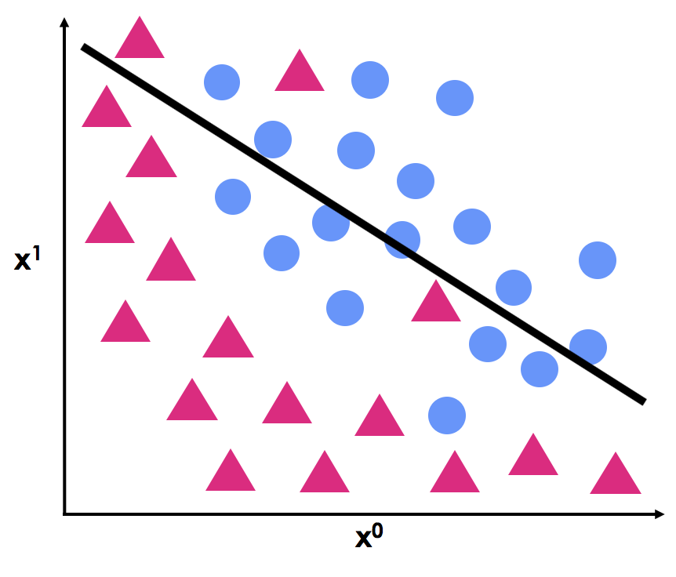
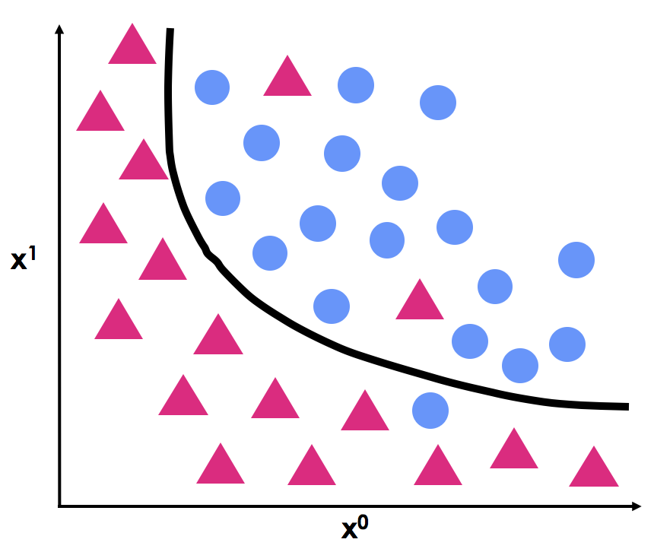
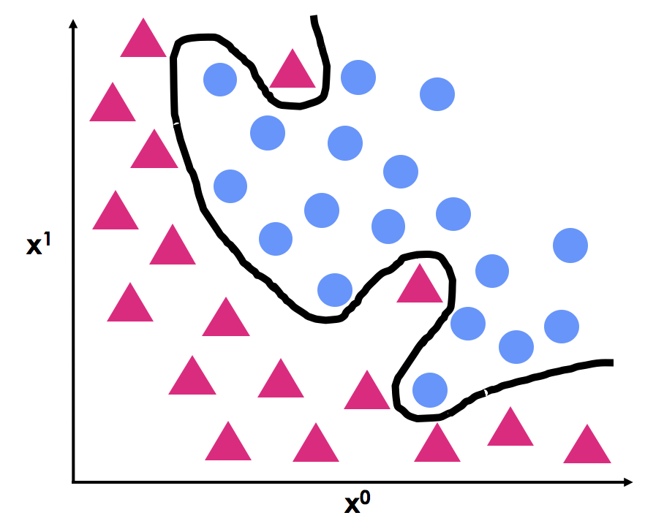
Outcomes from training
Training the network
Training the network
Classifier 1
Classifier 2
Classifier 3

Slide 39
Outcomes from training
Outcomes from training
Training the network
Training the network
Classifier 1
Classifier 2
Classifier 3
Accuracy
82%
91%
100%

Slide 40
Outcomes from training
Outcomes from training
Training the network
Training the network
Classifier 1
Classifier 2
Classifier 3
Accuracy
82%
91%
100%
Increasing training accuracy

Slide 41
Outcomes from training
Outcomes from training
Training the network
Training the network
Classifier 1
Classifier 2
Classifier 3
Accuracy
82%
91%
100%
Increasing training accuracy

Slide 42
Outcomes from training
Outcomes from training
Training the network
Training the network
Classifier 1
Classifier 2
Classifier 3

Slide 43
Performance on test data
Training the network
Training the network
Classifier 1
Classifier 2
Classifier 3

Slide 44
Performance on test data
Performance on test data
Training the network
Training the network
Classifier 1
Classifier 2
Classifier 3

Slide 45
Performance on test data
Performance on test data
Training the network
Training the network
Classifier 1
Classifier 2
Classifier 3
Group B: Incorrect
Group A:
Correct
Group B: Incorrect

Slide 46
Performance on test data
Performance on test data
Training the network
Training the network
Classifier 1
Classifier 2
Classifier 3
Group B: Incorrect
Group A:
Correct
Group B: Incorrect
Underfitted
Good fit
Overfitted

Slide 47
Performance on test data
Performance on test data
Training the network
Training the network
Classifier 1
Classifier 2
Classifier 3
Group B: Incorrect
Group A:
Correct
Group B: Incorrect
Underfitted
Good fit
Overfitted

Slide 48
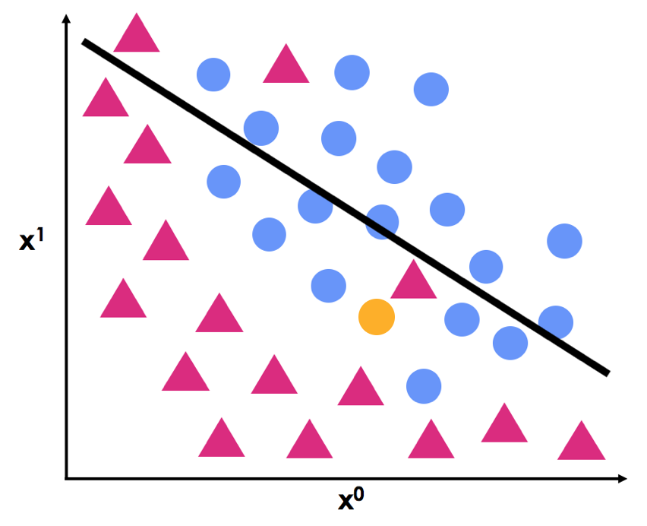
Underfitting
Training the network
Training the network
Underfitting – an error that occurs when a model is too simple to represent the underlying pattern in the dataset and population
Leads to low performance on training and testing
Address by increasing model complexity
Add features/layers
Increase training duration
Underfitted

Slide 49
Performance on test data
Performance on test data
Performance on test data
Training the network
Training the network
Classifier 1
Classifier 2
Classifier 3
Group B: Incorrect
Group A:
Correct
Group B: Incorrect
Underfitted
Good fit
Overfitted

Slide 50
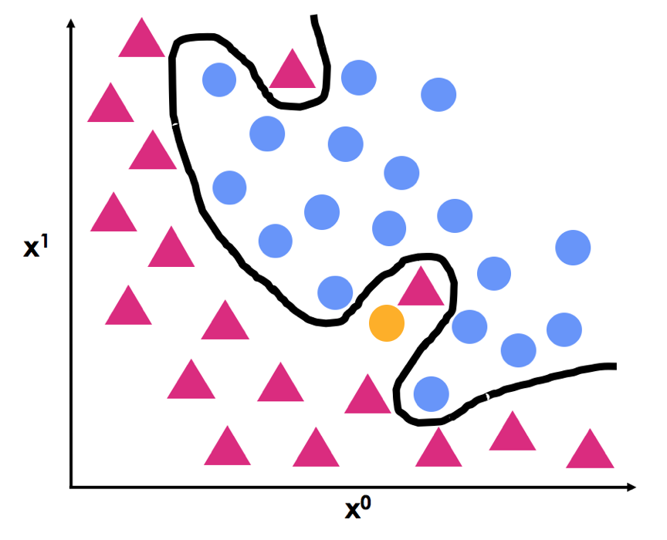
Overfitting
Overfitting
Training the network
Training the network
Overfitting – an error that occurs when a model is more complex than the underlying pattern in the population, often due to fitting too closely to the training dataset
Leads to high performance on training and low performance on testing
Model may be picking up noise or outliers in dataset
Several techniques to address
Overfitted

Slide 51
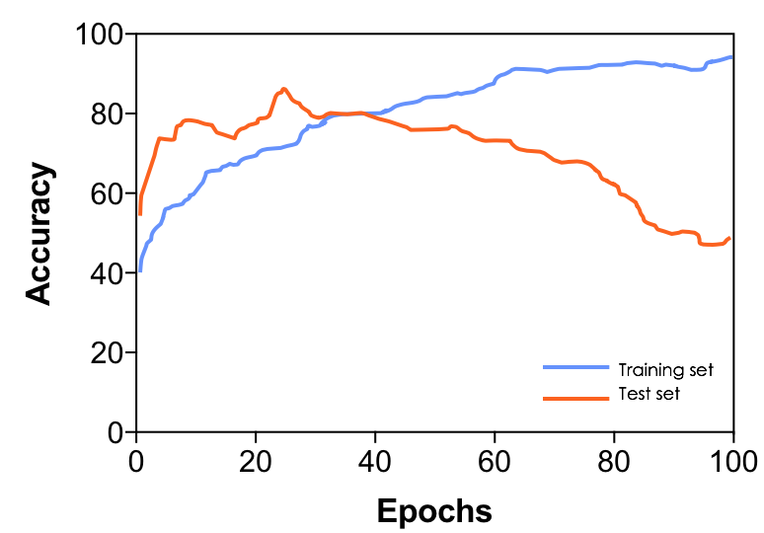
Detecting overfitting - accuracy
Overfitting
Training the network
Model is very accurate on training set
Reduced accuracy on test set
Observe discrepancies between training and test data

Slide 52
Detecting overfitting - loss
Training set
Test set
Loss is larger and increasing for test set
Loss is small and decreasing for training set
Observe discrepancies between training and test data

Slide 53
Early stopping
Underfit
Overfit
Training set
Test set
Early-Stopping – a technique that prevents overfitting by stopping training process when chosen model performance stops improving on the test set
Model at time of stoppage is used for task
Stop training

Slide 54
Working scheme for neural network experiments
Train model with training set
Evaluate model using test set
Tweak model based on performances
Pick model that performs best on test set

Slide 55
Working scheme for neural network experiments
Train model with training set
Evaluate model using test set
Tweak model based on performances
Problem: The test set is used to choose the model → overfitting to test data

Slide 56
Training and test sets
Training and test sets
Test
Training

Slide 57
Validation set
Validation set – dataset used to choose the model to use
Allows for comparing performance on unseen data between different models
Ensures that evaluation on testing set represents a true measurement of performance on an unseen dataset
Test
Training
Validation

Slide 58
Summary
Training set – for learning
Informs the parameters: weights and biases of model
Validation set – for tuning
Informs the hyperparameters: e. g. architecture, complexity
Test set – for evaluation
Informs performance on unseen data. Not used until model is completely fixed
Test
Training
Validation

Slide 59
Summary
Summary
Training set – for learning
Informs the parameters: weights and biases of model
Validation set – for tuning
Informs the hyperparameters: e. g. architecture, complexity
Test set – for evaluation
Informs performance on unseen data. Not used until model is completely fixed
Test
Training
Validation
The naming is sometimes reversed in other sources

Slide 60
Working scheme for neural network experiments
Train model with training set
Evaluate model using validation set
Tweak model based on performances
Pick model that performs best on validation set
Evaluate model using test set

Slide 61
Working scheme for neural network experiments
Train model with training set
Evaluate model using validation set
Tweak model based on performances
Pick model that performs best on validation set
Evaluate model using test set
What are some potential limitations?

Slide 62
Problems with our current approach
Training
Training
Validation
Training on less data → overfitting during training
Potential for data bias (overly lucky/unlucky split)
Repeat split at random and take average performance

Slide 63
Cross Validation
Cross-validation – an experimental set-up where we divide the dataset into subsets (i.e. folds) that will be used sequentially for evaluation with each iteration.
K-fold cross-validation:
K is the number of folds into which the dataset is split

Slide 64
K-fold cross validation
Randomly shuffle the training set
Training Dataset

Slide 65
K-fold cross validation
K-fold cross validation
Randomly shuffle the training set
Divide dataset into k unique groups (here k = 4)
Subset 1
Subset 2
Subset 3
Subset 4

Slide 66
K-fold cross validation
K-fold cross validation
Randomly shuffle the training set
Divide dataset into k unique groups (here k = 4)
For each subset:
Assign it as validation
train model on remaining k-1 subsets
Perform evaluation on validation set and keep metrics
Training
Training
Training
Validation
Iteration 1

Slide 67
K-fold cross validation
K-fold cross validation
Training
Training
Training
Training
Training
Training
Validation
Validation
Iteration 1

Slide 68
K-fold cross validation
K-fold cross validation
Repeat previous step for remaining subsets
Training
Training
Training
Validation
Iteration 1

Slide 69
K-fold cross validation
K-fold cross validation
Repeat previous step for remaining subsets
Training
Training
Training
Validation
Iteration 1
Training
Training
Validation
Training
Iteration 2
Training
Validation
Training
Training
Iteration 3
Validation
Training
Training
Training
Iteration 4

Slide 70
K-fold cross validation
K-fold cross validation
Repeat previous step for remaining subsets
Training
Training
Training
Validation
Iteration 1
Training
Training
Validation
Training
Iteration 2
Training
Validation
Training
Training
Iteration 3
Validation
Training
Training
Training
Iteration 4

Slide 71
K-fold cross validation
K-fold cross validation
Repeat previous step for remaining subsets
Summarize evaluation scores across iterations to assess performance
Training
Training
Training
Validation
Iteration 1
Training
Training
Validation
Training
Iteration 2
Training
Validation
Training
Training
Iteration 3
Validation
Training
Training
Training
Iteration 4

Slide 72
K-fold cross validation
K-fold cross validation
Repeat previous step for remaining subsets
Summarize evaluation scores across iterations to assess performance
Model accuracy
Training
Training
Training
Validation
85%
Iteration 1
Training
Training
Validation
Training
89%
Iteration 2
Average
Training
Validation
Training
Training
Iteration 3
92%
Validation
Training
Training
Training
Iteration 4
88%

Slide 73
Summary of k-fold cross validation
Randomly shuffle the training set
Divide dataset into k unique groups (here k = 4)
For each subset:
Assign it as validation
train model on remaining k-1 subsets
Perform evaluation on validation set and keep metrics
Repeat previous step for remaining subsets
Summarize evaluation scores across iterations to assess performance

Slide 74
How to select the parameter, k
Larger k:
Larger training set: better performance
Smaller validation set: weaker conclusions
K = 2, 5,10, N → common choice used in the field
K = N (total number of samples)
Each sample is individually held-out as validation
Called leave-one-out cross-validation (LOO-CV)

Slide 75
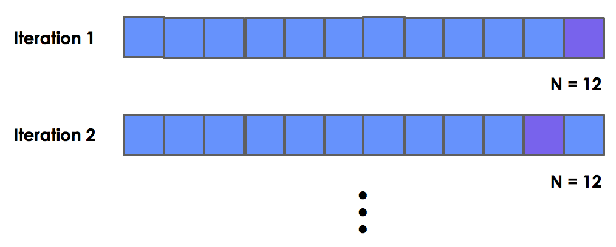
Leave-one-out cross validation
Good for when datasets are small

Slide 76
Advantages of cross-validation
Utilizes all training samples at some point
Reduces biases in datasets due to split choice

Slide 77
Disadvantages of cross-validation
Disadvantages of cross-validation
There are k models that results from k-fold cross validation
Uncertainty on which to use for future work
Conclusions about performance are about the “type” of model rather than one specific model

Slide 78
Working scheme for neural network experiments with cross-validation
Disadvantages of cross-validation
Train and evaluate model type using cross validation
Tweak model type based on performances
Pick model type that performs best on cross-validation
Pick one model
Evaluate model using test set

Slide 79
How much data do you need?

Slide 80
How much data do you need?
Disadvantages of cross-validation
This question is very difficult to answer in the world of deep learning
It depends on variation in your population and how much your dataset represents it
The key: maximize representation!

Slide 81
How to maximize representation?
Get more data
Larger datasets have a higher chance of representing the population well compared to smaller datasets
Get data from multiple sources (e.g. different centers, different countries)
Balance or at least match the population’s demographic information (e.g. age, gender)

Slide 82
Maximize training or testing?
Maximizing representation in the training and validation sets:
Higher performance on the test set
Maximizing representation in the testing set:
Stronger proof of generalizability
More likely to be used
Maximize the training set representation and use the high performance on validation as a motivation for collecting data to form a more representative testing set

Slide 83
Example scenario
Question: Is there an association between brain mass and IQ scores?
Data: We have the budget to get 40 brain volumes from AKTH and participants’ associated IQ scores
Does it make sense to use cross validation in our analysis?
What percentage should go to training? Validation? Testing?
How can we maximize representation of our dataset?

Slide 84
Example scenario
Example scenario
Question: develop a model that detects cancer cells
Data: We have 10,000 digital pathology scans of lung tissue. 10% are scans of cancer, the rest are healthy tissue.
Does it make sense to use cross validation in our analysis?
What percentage should go to training? Validation? Testing?
What should we check in terms of representation of our datase?

Slide 85
Reading all data
Recall: loading the data involves copying it from permanent storage (e.g. hard drive, SSD) to random-access memory (RAM)
RAM is limited, (e.g. 8 GB, 16 GB, 32 GB)
What if you have more data than you can load in RAM?
You can:
Write a function that loads a few at a time based on your memory constraints. It will need:
Available RAM amount
The size of your images in memory
Let PyTorch manage it for you!

Slide 86
PyTorch image data generator
Image data generator can load images from permanent storage (e.g. hard drive, SSD) in batches
Storage
RAM

Slide 87

PyTorch image data generator
Image data generator can load images from hard drive in batches
Give the generator the location of images in memory
Batch of 4 images
Storage
D:/path/to/files
RAM

Slide 88
PyTorch image data generator
Image data generator can load images from hard drive in batches
Give the generator the location of images in memory
Instead of loading all images, loads a batch of images
Batch of 4 images
Storage
D:/path/to/files
RAM

Slide 89
PyTorch image data generator
Image data generator can load images from hard drive in batches
Give the generator the location of images in memory
Loads next batch of images onto RAM, after removing old batch
Next batch of 4 images
Storage
D:/path/to/files
RAM

Slide 90
PyTorch image data generator
Image data generator can load images from hard drive in batches
Give the generator the location of images in memory
Loads next batch of images onto RAM, after removing old batch
Next batch of 4 images
Storage
D:/path/to/files
RAM

Slide 91
PyTorch image data generator
Images are only loaded onto RAM as needed
Next batch of 4 images
Storage
D:/path/to/files
RAM

Slide 92
PyTorch image data generator
Images are only loaded onto RAM as needed
Train using a large amount of data, without loading all data at once
Batch size limited by available RAM
Next batch of 4 images
Storage
D:/path/to/files
RAM

Slide 93
PyTorch image data generator
Images are only loaded onto RAM as needed
Train using a large amount of data, without loading all data at once
Batch size limited by available RAM
PyTorch can apply augmentation before training
Apply augmentation
Storage
D:/path/to/files
RAM

Slide 94
Assignment Discussion
Assignment 1
Week 7: ANN Heart Failure Prediction
https://www.kaggle.com/competitions/week-7-ann-heart-failure-prediction
Assignment 2
Week 7: Brain Tumor Classification Challenge
https://www.kaggle.com/competitions/week-7-brain-tumor-classification-challenge
Let's Go To GitHub
AND Kaggle

